Slide 1
eduroam series
Installation and Configuration of eduroam server and FLR

Slide 2
Introduction
Derrick Ssemanda
Systems and Software Engineer
Research and Education Network for Uganda (RENU)
Email
dssemanda@renu.ac.ug
systems@renu.ac.ug

Slide 3
About this presentation
Installing and configuration of eduroam server and Federation Level Radius (FLR)
Brief introduction to some concepts.
All of them as technical as possible
All in relatively easy and relatable terms
Sorry – It has less politics
Also included; Proposed consideration for an African CTLR

Slide 4
eduroam
Outline
Introduction
Terminology
General
eduroam - technically
Comparison with other technologies
Basic introduction

Slide 6
eduroam
SSID with the name ‘eduroam’ (Fully lower case)
WPA2-Enterprise
Authentication with help of RADIUS
Group of RADIUS and Proxy servers working together
Each RADIUS server handles at least 1 realm/domain
Username in the format user@realm
For example; systems@renu.ac.ug, user - systems, realm - renu.ac.ug

Slide 7
Terminologies
Outline
APs
IMS
IdP
SP
Proxy
FLR
TLR
Definitions of some terms

Slide 8
Access Points ( APs)
Provides users with access to resources
Uses local or external authentication
For external authentication, it sends out an Access-Request based on the credentials provided
It sends it out to the RADIUS server(SP) and waits for an Access-Accept or a Access-Reject

Slide 9
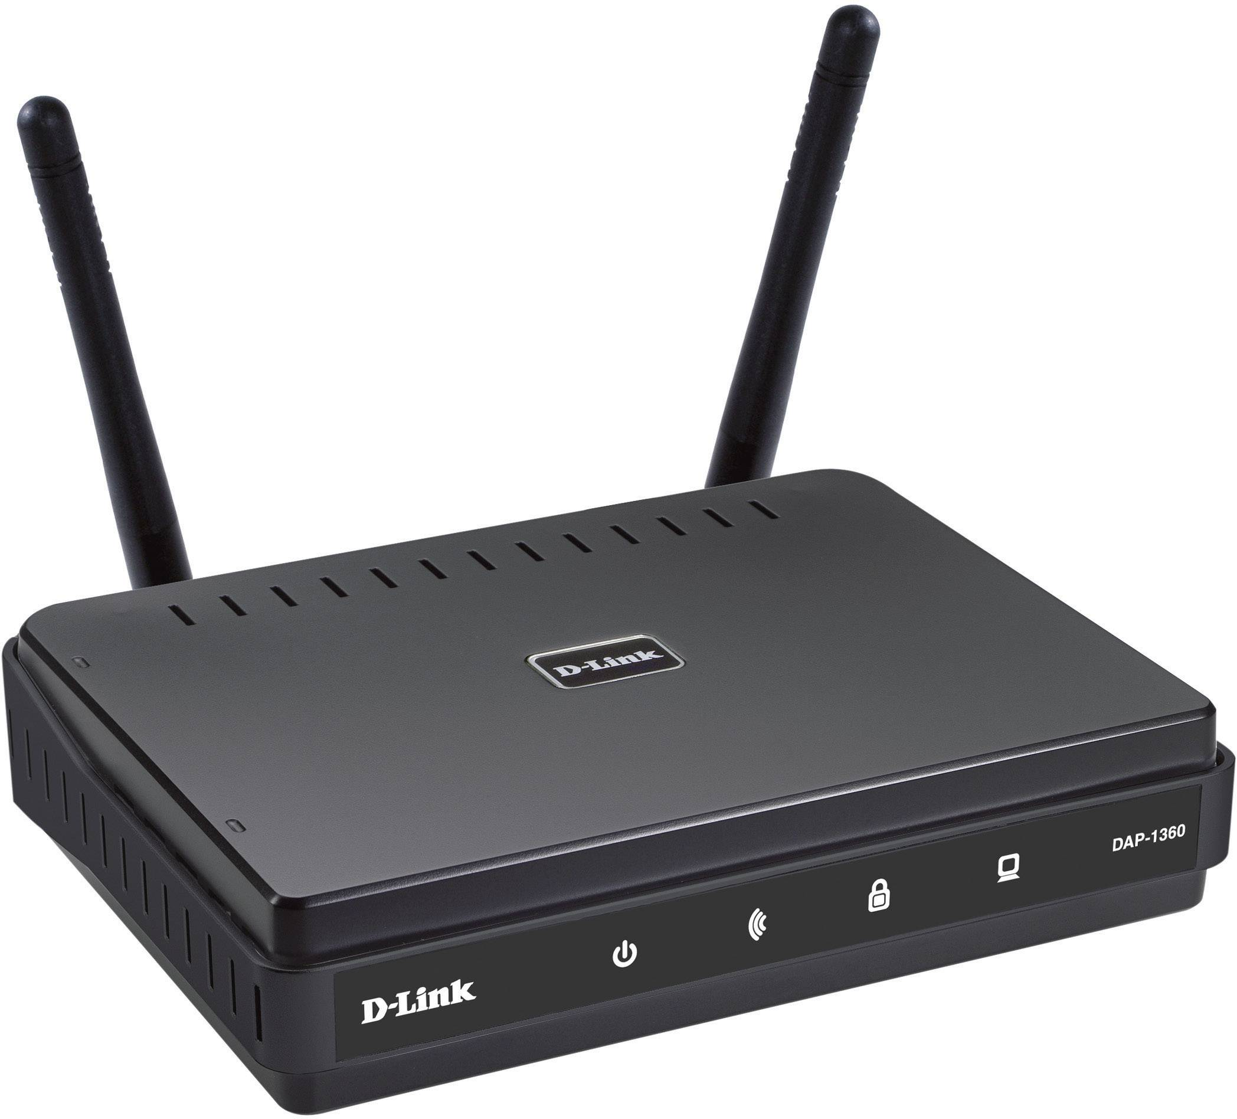
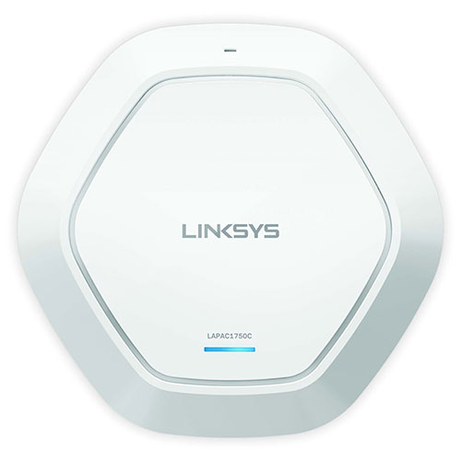
Examples
Ubiquiti
TP-Link
Cambium
D-Link
MikroTik
Linksys

Slide 10
Service Provider ( SP )
RADIUS server
Forwards requests from APs to other RADIUS servers(IdP or FLR)
As well as returning Access-Accept/Aeject back to the AP
Examples include; FreeRADIUS3, daloRADIUS

Slide 11
Identity Provider ( IdP )
Sometimes referred to as home_server
Receives requests from other RADIUS or proxy servers
Checks and authenticates the user in the request using a user database(IMS) it is configured to connect to
Returns Access-Accept/Reject

Slide 12
Identity Management System ( IMS )
Fancy title
Sometimes referred to as Identity Management (IDM)
One or set of tools which manage user life cycle
Can range from text files, excel documents all the way to Active Directory/Directory service
IdP authenticates users by checking from any IMS its configured to connect to
Another term: Identity and Access Management (IAM)

Slide 13
Examples
Text files
Excel Sheet
SQL Databases
FreeIPA
Windows Active Directory
Source: https://wxbcyber.com/user-lifecycle-management.php

Slide 14
eduroam - proxying
Local authentications handled by server
External authentications are proxied out to their home server
Connections in between involve proxy server
These servers include FLR and TLR

Slide 15
Federation Level Radius ( FLR )
Federation Level RADIUS
Responsible for at least one top-level domain
E.g. *.ug for Uganda
Connects eduroam servers together

Slide 16
Confederation top-level RADIUS server ( TLR )
Confederation top-level RADIUS server
Connects FLRs together

Slide 17
eduroam - Technically

Slide 18
eduroam - Technically
Mobile devices save a connection profile for each SSID
Research networks agreed to use an SSID “eduroam”
This SSID is similar across the globe and uses WPA2-Enterprise
The mobile device will connect to SSID in the same way as always when it detects using the saved profile
A network of RADIUS servers ensures that the same profile works by proxying it back to the home IdP which authenticates the device

Slide 19
Comparison with other technologies

Slide 20
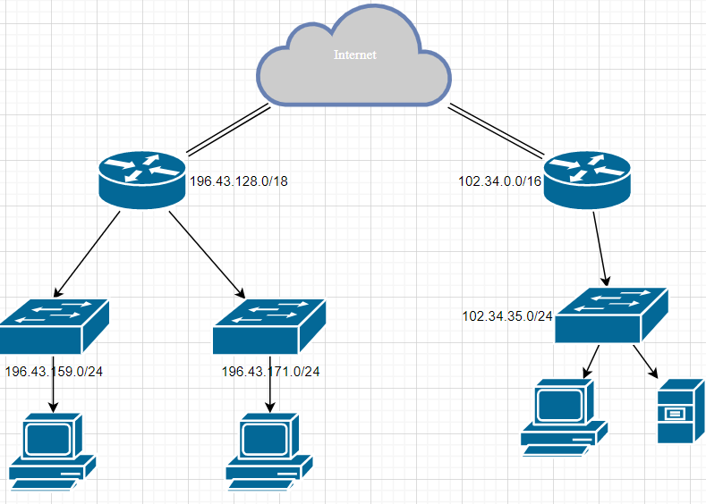
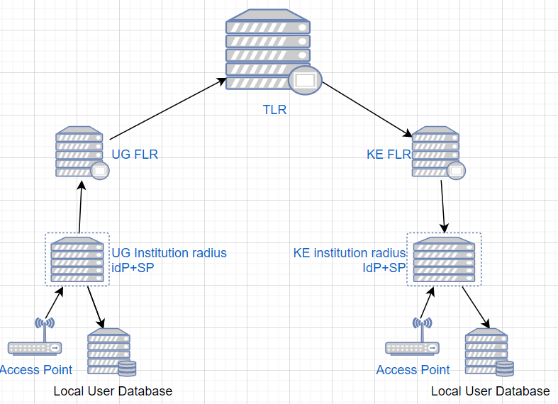
Comparison with Network
L3 Network
RADIUS network

Slide 21
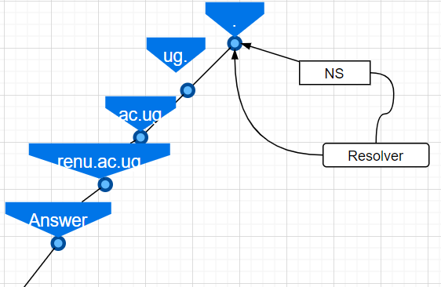
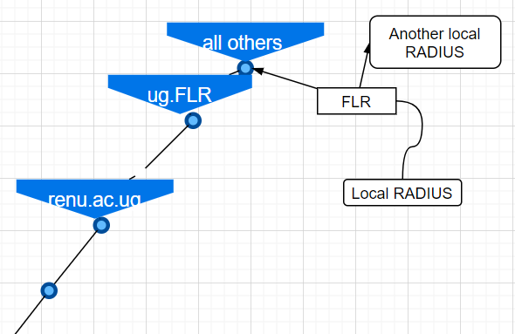
Comparison with DNS
DNS
RADIUS

Slide 22
eduroam
Outline
Introduction
Structure
Deployment
Testing and Troubleshooting
Deployment with FreeRADIUS3

Slide 23
Introduction - freeRADIUS
Most popular RADIUS server
Opensource
Scalable
Feature rich
Supports virtual sites

Slide 24
Structure
Similar to Apache2
Mods-enabled symlink used modules from mods-enabled
Same applies to sites
Accepts connections from NAS mentioned in clients.conf
Proxies requests according to the proxy.conf

Slide 25
Structure – Core config files
radiusd.conf
Clients.conf
Proxy.conf
sites-enabled/*
mods-enabled/*

Slide 26
Structure – radiusd.conf
Reading freeRADIUS configs starts here
Defines the configuration parameters for the server
Includes references to all other config files

Slide 27
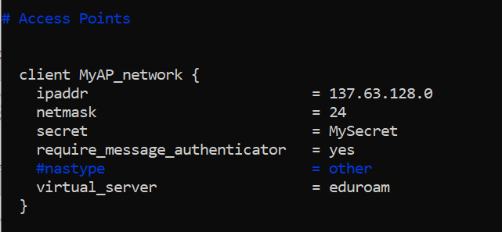
Structure – clients.conf
APs which connect to the RADIUS are added here
Defines necessary information to configure a RADIUS client (AP)

Slide 28
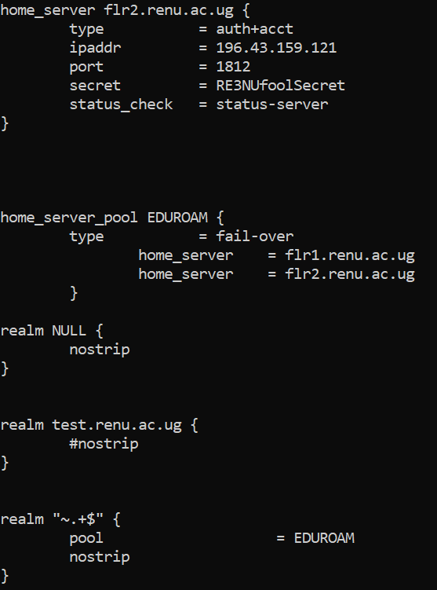
Structure – proxy.conf
RADIUS proxies are mentioned here
In a similar way, decisions on which proxy server to send a request from a realm is also specifies here

Slide 29
Structure – proxy.conf Cont’d
Proxy servers are defined as ‘home_server’
And they forward to realms/domains as per the configuration

Slide 30
Structure – sites-enabled/
Stores virtual sites
These symlink to sites-available
eduroam is configured here, as well as eduroam-inner-tunnel

Slide 31
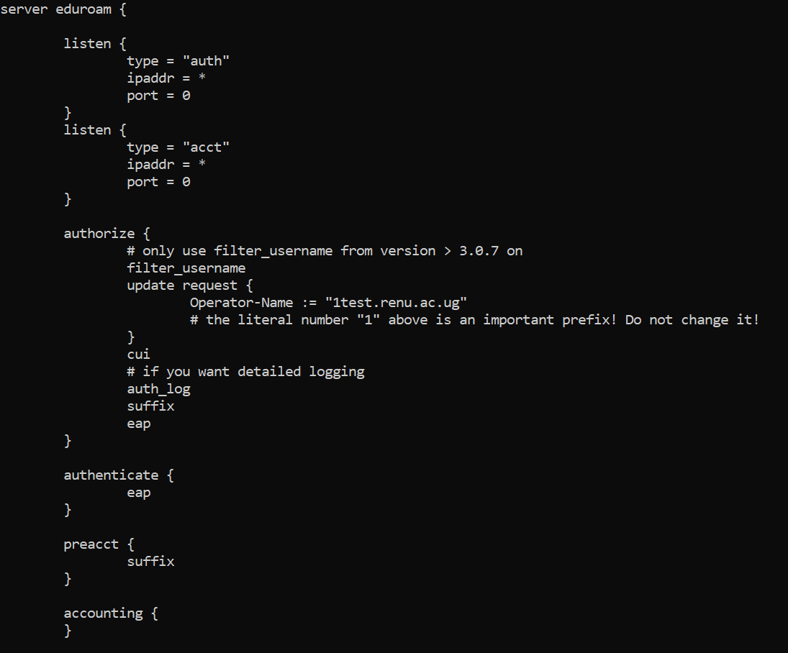
Structure – sites-enabled/virtual-site
Defines a server.
Within the server, it defines the subsections
Then places mods within a subsection
In each subsection, the modules are run in order

Slide 32
Structure – mods-enabled/*
Files symlink to mods-available
Contains modules used by the virtual site
Each module is made up of a module name and can contain either zero or more variables definitions
Modules are loaded into a virtual site by listing them in a subsection

Slide 33
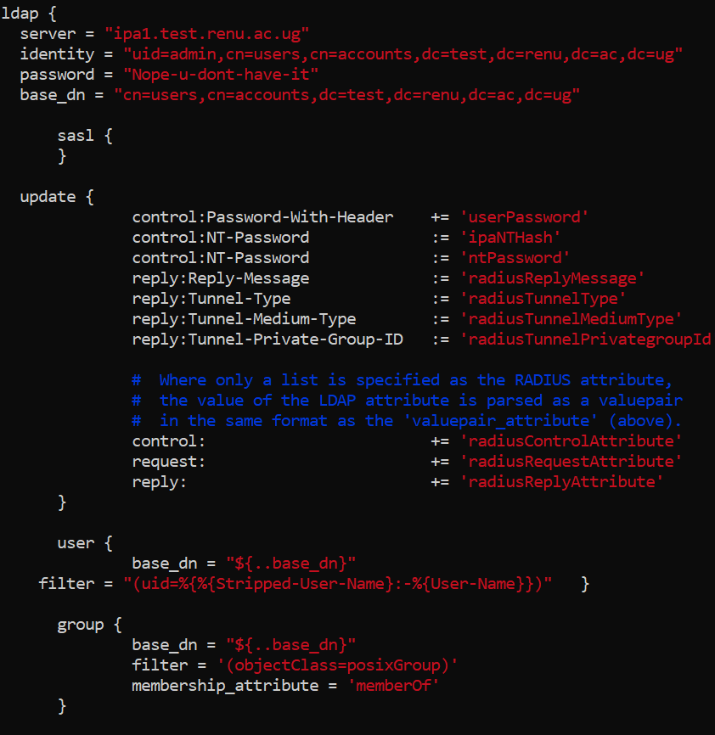
Structure – mods-enabled/module
A module is built from rlm_module
Files here are enabled files containing variables for the modules
Each file normally contains variables for one module
Notes:
This should give an explanation to as why you still have to install freeradius-ldap

Slide 34
Deployment - Requirements
Ubuntu 18 server with access to the internet

Slide 35
Deployment
Clone git: https://github.com/RENUUG/eduroamIdP
Copy paste template, clients, secrets and inventory
Edit radius_flr.yml
Run script
Notes:
Doesn't have other DBs yet

Slide 36
Demo

Slide 37
Walk Through
Notes:
What we have done

Slide 38
Troubleshooting Tips
Check and confirm that indentation is okay
Run the command “freeradius –X”
This informs you where the errors are arising from

Slide 39
FLR server
Outline
Introduction
Structure
Deployment
Testing
Deployment with radsecproxy

Slide 40
Introduction
Generic RADIUS proxy
Flexible
Small
Efficient
Easy to configure
Supports both IPv4 and IPv6

Slide 41
Structure
Basically has one initial config file
Default location: /usr/local/etc/radsecproxy.conf
Other files can be added by including them in this file
Installation comes with radsecproxy-hash which prints hash of Ethernet MAC addresses

Slide 42
Structure – radsecproxy.conf
Proxy server checks this file when the service is started. Returns error if not found
Can include other files
Ignores whitespace
Comments using #
Uses a block structure as shown below
client newone{
some_commands here
}

Slide 43
Deployment – Pre-installation
On an Ubuntu 18 server, upgrade all packages
Install software packages that will help in compiling radsecproxy
apt install build-essential libssl-dev nettle-bin nettle-dev wget

Slide 44
Deployment - Installation
Download latest version (https://radsecproxy.github.io/)
Unzip and change directory to the new folder created
Make installations from source files using
./configure ; make ; make check; make install
Create radsecproxy.conf file – [template attached]
Create system unit files – [template attached]
Enable it to start on start up
Notes:
Supposed to be on different lines but don’t have space

Slide 45
Deployment - Configuration
Edit radsecproxy.conf
Add or remove content
Restart radsecproxy

Slide 46
Demo

Slide 47
African TLR
Proposed diagram
Software to be used
Advantages
Considerations for an African CTLR

Slide 48
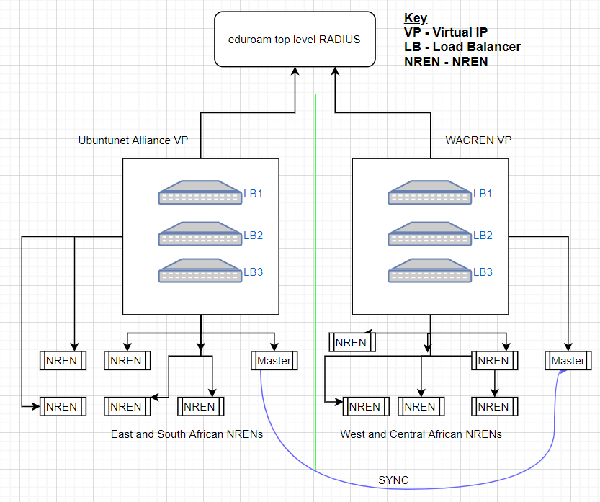
Diagram

Slide 49
Software Used
Radsecproxy
Haproxy – Load balancing
Ansible
Rsync
All open source

Slide 50
Advantages of this model
No single point of failure
Load balancing can easily be implemented
Set up costs are easily distributed
Another step at African collaboration
Notes:
African NRENS can still eduroam without the need for external
Can also remain operation in case of anything happening to the top level RADIUS servers

Slide 51
Conclusion

Slide 52
REFERENCES
https://wiki.geant.org/display/H2eduroam/freeradius-sp
https://wiki.geant.org/pages/viewpage.action?pageId=121346324
https://radsecproxy.github.io/radsecproxy.conf.html

Slide 53
THE END
Thank you for your time

