Slide 1
The evolution of Authentication at institutions
local login, SSO, Federation

Slide 2
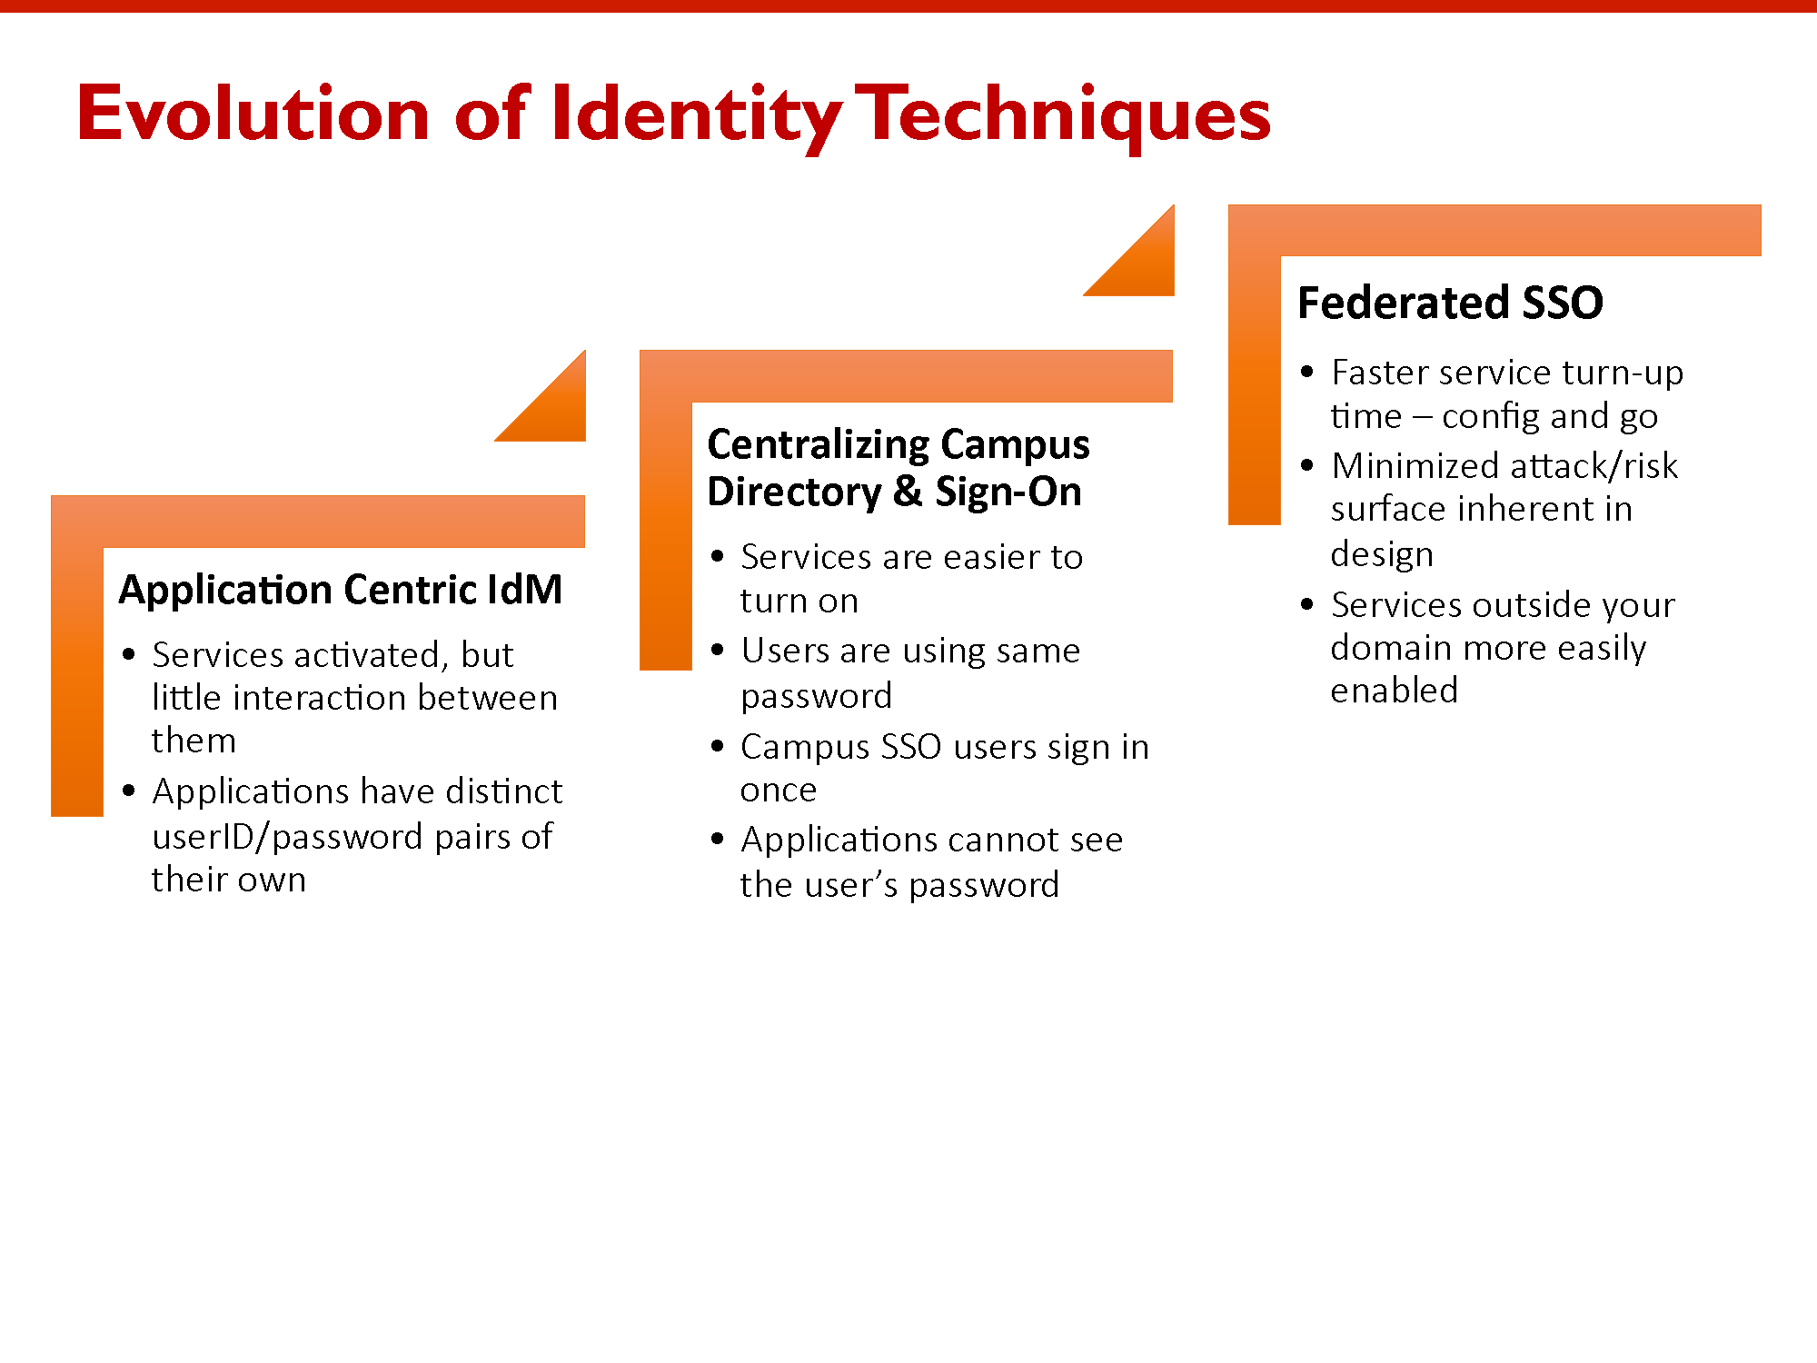

Notes:
Approach this as an evolution of authentication at institutions - local login, SSO, Federation
- touch on the common "lifecycle" of Authentication to services at institutions, and how having evolved authentication mechanisms, pave the way to what services can eventually be federated.
- for you to realise where your institutions may be in this evolution and answer “whats the point of this federation thing?“
- To help you also understand at what point in this, your federations may be, and where you can help guide them to be going.
- having worked at institutions, the end goal, and it's benefits are often missed, and in the African context let's face it. - to-do lists are large, with few hands, and ‘That person from the Library that cornered me at a meeting, and said,
"so, I spoke with someone who said you can help with getting this SSO or Federation thing going“’
- Guy chatting with Caroline Dean.
- I will also be showing you some example at the end of the slides.

Slide 3
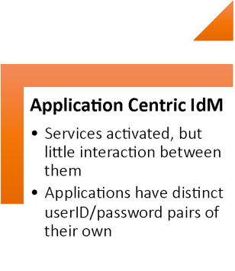
First adaptation

Slide 4

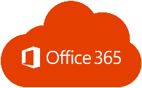



Notes:
The First adaptation - Each system requires a user account to be created
- next slide - We have institution A, Institution A has moodle as their LMS, Moodle has it's own user database, or they might have SAKAI, this also has it's own user database, they may have O365, with it's user database
They may also have DSPACE for the library, also with it's own user database....each internal user, as well as a guest to that institution have a common problem....Please sir, can I have some access.
- As you can imagine,...This model makes it extremely difficult for the user, and Administrator
- As users will need to request access to each system
- they will need to remember a username and password for each system, ontop of remembering a password for all other systems they could have access to
- Each system may have different support structures, ie. Be looked after by someone else, so now the user will need to get hold of that person.
- Administrative overhead if a user forgets his password
- Passwords are potentially stored in clear text, on each application
- This model makes it hard to federate the service too
- Results in bad user experience

Slide 5
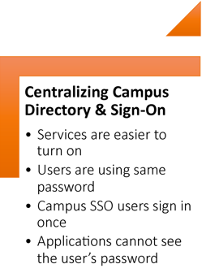
Second adaptation

Slide 6

Notes:
The Second adaption Enter SSO
- next slide - again, we have institution A, Institution A has all these applications, but now, these applications are being configured to authenticate against a central Directory, or Registry, This can be done via LDAP
but aside from LDAP being deprecated, hello 2020, LDAP authentication will also mean the user needs to sign on to every application he/she wants to access, since LDAP does not transfer any kind of token, thus
is not Single Sign-on.
- Internal Users may still need to ask for access, depending on if there is working identity Management, but only now needs to ask/be granted access to a central directory
- Such an adaption means not asking for access, or to login to each and every system anymore, which reduces the amount of passwords users need to remember, and also allows for users to potentially
manage their own passwords via a centralised Password Self-Service application
- guests will still face the challenge however, that they still may need to ask for access, which if no Identity Management is in place may still create administrative overhead of
needing to manage an external entity, as well as your guest user needing to remember multiple identities, and the associated passwords
Centralising your Applications Identity/Authentication source via a Single Sign on Application such as ADFS, or SimpleSAMLPHP, or Shibboleth IdP not only improves user experience (smile face), but also improves Security,
as your applications no longer need to know your users password, Your users also get accustomed to one way of accessing services via their institutions SSO page, which also helps to alleviate the potential reach of phishing attempts.
The second adaption, is where most institutions are in our experience. Starts with institutions federating their internal services on their campus using their internal SSO, and thus leads us to the third adaption
Setting up SSO goes hand in hand with AAI, or Authentication, Authorisation infrastructure, as when you manage a shared application, you must guarantee it is accessed only by people that have the right to use it.
I will briefly go into a little more detail on AAI in my next session

Slide 7
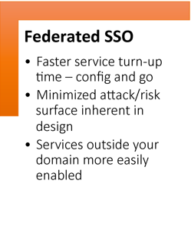
Third adaptation

Slide 8



Notes:
The third adaption
- next Slide - We know this image from the previous adaption...Institution A has all these applications, but now, these applications are being configured to authenticate against a central Directory, or Registry, local and guest users need to exist in the certal directory.
But consider that Institution A, and Institution B have their internal applications federated with a central SSO, and both now have an Identity Provider their users know how to use,
- We now have the building blocks in place to create federated services between the institutions ->
show Slides
to achieve this, the two parties can exchange the necessary Identity Provider, and Service Provider metadata containing entity information, and assertion signing keys. in order to implement a bilateral relationship meaning user from institution A, can use his home institution credentials, to login to the LMS at institution B - Bilateral arrangements however do not scale, since it means you need to then do the same thing for every application, and/or
institution that you want to interact with
- this can be taken another step further where we create what we call a multilateral relationship, with the likes of a Academic Identity Federation Where institution A, and B, exchange their IdP metadata with the
Academic Federation, an institution can also share it's LMS metadata with the federation - thereby allowing a user from the other institution to access that LMS - by extension this means that if more institutions join the
Academic Federation in this way, it means that the hard work is already done, and they could also access that LMS (provided the LMS authorises that access - which is another conversation for another day)
- Our Academic Federations can also have exchanged metadata with other inter federations, which now means that those institutions can also access the 3000+ services that exist in federations around the world

Slide 9
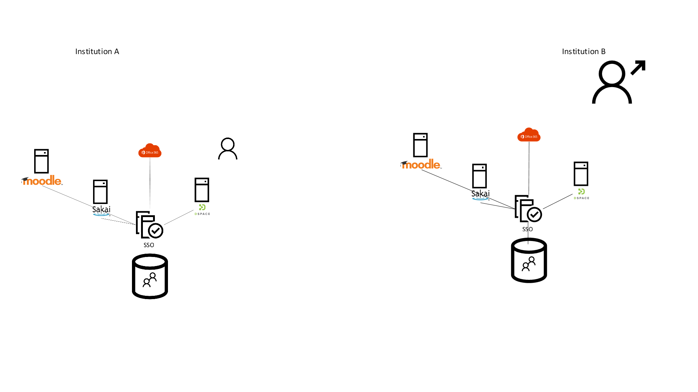
IdP metadata
SP metadata
Notes:
The third adaption
- next Slide - We know this image from the previous adaption...Institution A, and Institution B now have their internal applications federated with a central SSO, and both now have an Identity Provider their users know
how to use,
- We now have the building blocks in place to create federated services between the institutions ->
show Slides
to achieve this, the two parties can exchange the necessary Identity Provider, and Service Provider metadata (assertion signing keys, etc.) in order to implement a bilateral relationship meaning user from institution A,
can use his home institution credentials, to login to the LMS at institution B - Bilateral arrangements however do not scale, since it means you need to then do the same thing for every application, and/or
institution that you want to interact with
- this can be taken another step further where we create what we call a multilateral relationship, with the likes of a Academic Identity Federation Where institution A, and B, exchange their IdP metadata with the
Academic Federation, an institution can also share it's LMS metadata with the federation - thereby allowing a user from the other institution to access that LMS - by extension this means that if more institutions join the
Academic Federation in this way, it means that the hard work is already done, and they could also access that LMS (provided the LMS authorises that access – which again refers to AAI that I spoke of earlier.)
- Our Academic Federations can also have exchanged metadata with other inter federations, which now means that those institutions can also access the 3000+ services that exist in federations around the world – All these doors are opened to your institutions simply because they have taken the steps to simplify their authentication mechanisms.

Slide 10


metadata
metadata
metadata
Notes:
The third adaption
- next Slide - We know this image from the previous adaption...Institution A, and Institution B now have their internal applications federated with a central SSO, and both now have an Identity Provider their users know
how to use,
- We now have the building blocks in place to create federated services between the institutions ->
show Slides
to achieve this, the two parties can exchange the necessary Identity Provider, and Service Provider metadata (assertion signing keys, etc.) in order to implement a bilateral relationship meaning user from institution A,
can use his home institution credentials, to login to the LMS at institution B - Bilateral arrangements however do not scale, since it means you need to then do the same thing for every application, and/or
institution that you want to interact with
- this can be taken another step further where we create what we call a multilateral relationship, with the likes of a Academic Identity Federation Where institution A, and B, exchange their IdP metadata with the
Academic Federation, an institution can also share it's LMS metadata with the federation - thereby allowing a user from the other institution to access that LMS - by extension this means that if more institutions join the
Academic Federation in this way, it means that the hard work is already done, and they could also access that LMS (provided the LMS authorises that access – which again refers to AAI that I spoke of earlier.)
- Our Academic Federations can also have exchanged metadata with other inter federations, which now means that those institutions can also access the 3000+ services that exist in federations around the world

Slide 11
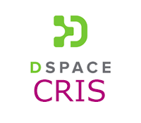







Notes:
Here are some examples of Services you may find on campus that we know can be federated, and of course one should not federate for the sake of federating applications.
In some cases, applications on campus may make sense for Single Sign-on but not necessarily to federate – stuff like Student Portals, HR websites, Password Self-Service applications .
Stuff makes sense to federate such as what you see on the slide – you will have seen in my previous slides I mentioned some of those,
It makes sense to think about federating LMS software as you may have realised from my previous slides, as it can go far in assisting researchers/students
moodle
Sakai
Other collaborative, CRIS systems (Current research information systems)
Converis
DSPACE-CRIS
Perhaps digital library journaling ,or repository systems such as
OJS – open journaling platform – non commercial academic publications – such as a book published by lecturers – similar commercial products is the likes of Taylor and Francis.
DSPACE – institutional repository usually used for student thesis/papers
And you will also see some smaller applications, such as filesender, or Sympa

Slide 12
Demo
Notes:
Demo:
Show evolution using examples
Explain first adaption according to CANARIE image of Application Centric IDM - 'local login’ – examples.nren.
Show Second adaption block login
Centralising Directory and Sign-on https://outlook.com/myuct.ac.za
https://vula.uct.ac.za
to moodle "UCT Account"
Demontrate SSO
Show third adaption - part 1 - bilateral relationship - 'Selected Institutions’ – examples.nren.ac.za, osf.uct.ac.za
part 2 - multi lateral relationship -'institutional login'

Slide 13
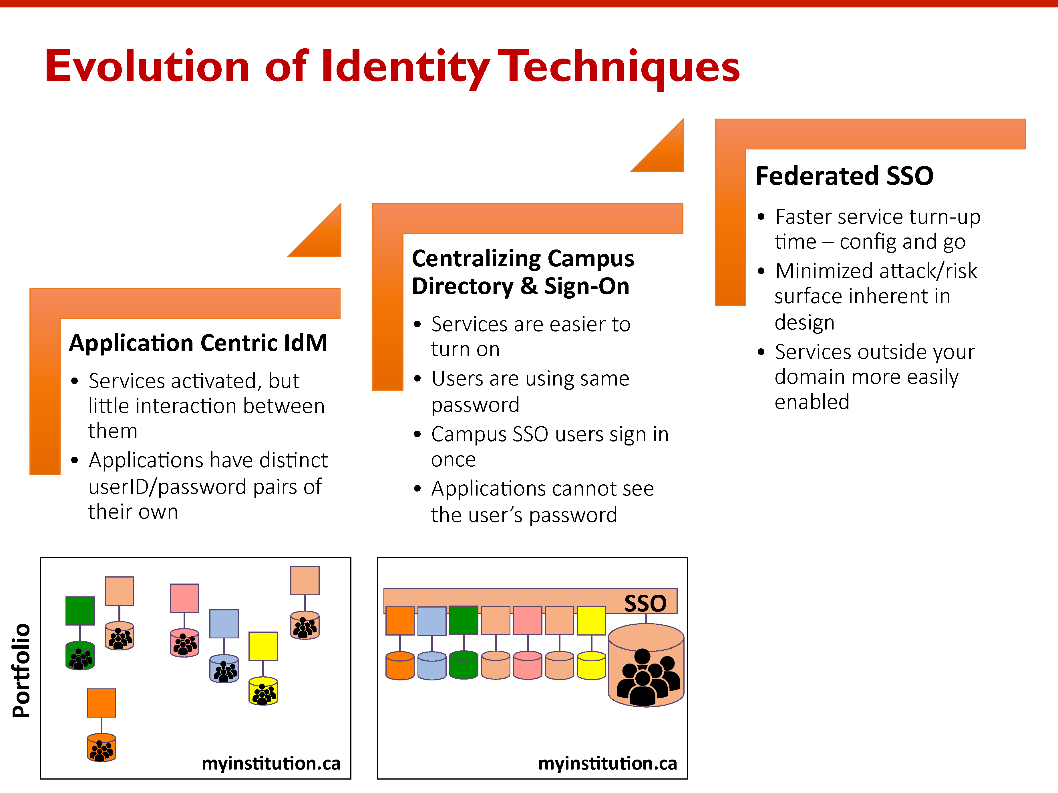
Notes:
Short Demo:
Show evolution using examples
Explain first adaption according to CANARIE image of Application Centric IDM - 'local login’
Show Second adaption block login to moodle "UCT Account" - Centralising Directory and demonstrate Sign-on – Use UCT outlook.com/myuct.ac.za, and https://eraonline.uct.ac.za/.
Show third adaption - part 1 - bilateral relationship – examples.nren ‘selected institutions’ – osf.uct.ac.za – each one of these institutions were not learned about via a interfederation, each one is set up individually where metadata is transferred between the entities, and the bilateral trust is established – as mentioned this creates a bit of an administrative overhead, as it is not automatically maintained – how do I know ? Because I worked at UCT, and I set this up ☺
part 2 - multi lateral relationship -'institutional login'

