Slide 1
The AARC Blueprint Architecture
Notes:
Now that we have spoken about the evolution of authentication, it can tie nicely into the AARC Blueprint Architecture.
AARC stands for Authentication and Authorisation for Research and Collaboration (AARC) - the AARC initiative was first launched in May 2015 to address the increased need for federated access and for authentication and authorisation mechanisms by research and e-infrastructures - I will get to Authentication and Authorisation in a bit
There will always be Researchers that are perhaps from IdP's who do not participate in federation, or Researchers who simply do not have an IdP
It is what the BPA is trying to help solve - the AARC blueprint architecture is a framework that aims to centralise business rules by providing building blocks to establish an architecture for a Research Community Proxy.
the Research Community Proxy architecture allows services in a research collaboration to connect to a single point, the proxy, which itself takes the responsibility for providing connections
to the identity federations in eduGAIN, and is meant to reduce the need for each service having to separately connect to a federation/eduGAIN.
As mentioned it is a framework, that provides the Building blocks – the framework can look overwhelming, but You don’t have to build it all, and take the framework as ‘step-by-step I must do it all’, you should just build what you need, and what makes sense to your community – which I will hopefully be able to show you in the demo in a little while.

Slide 2
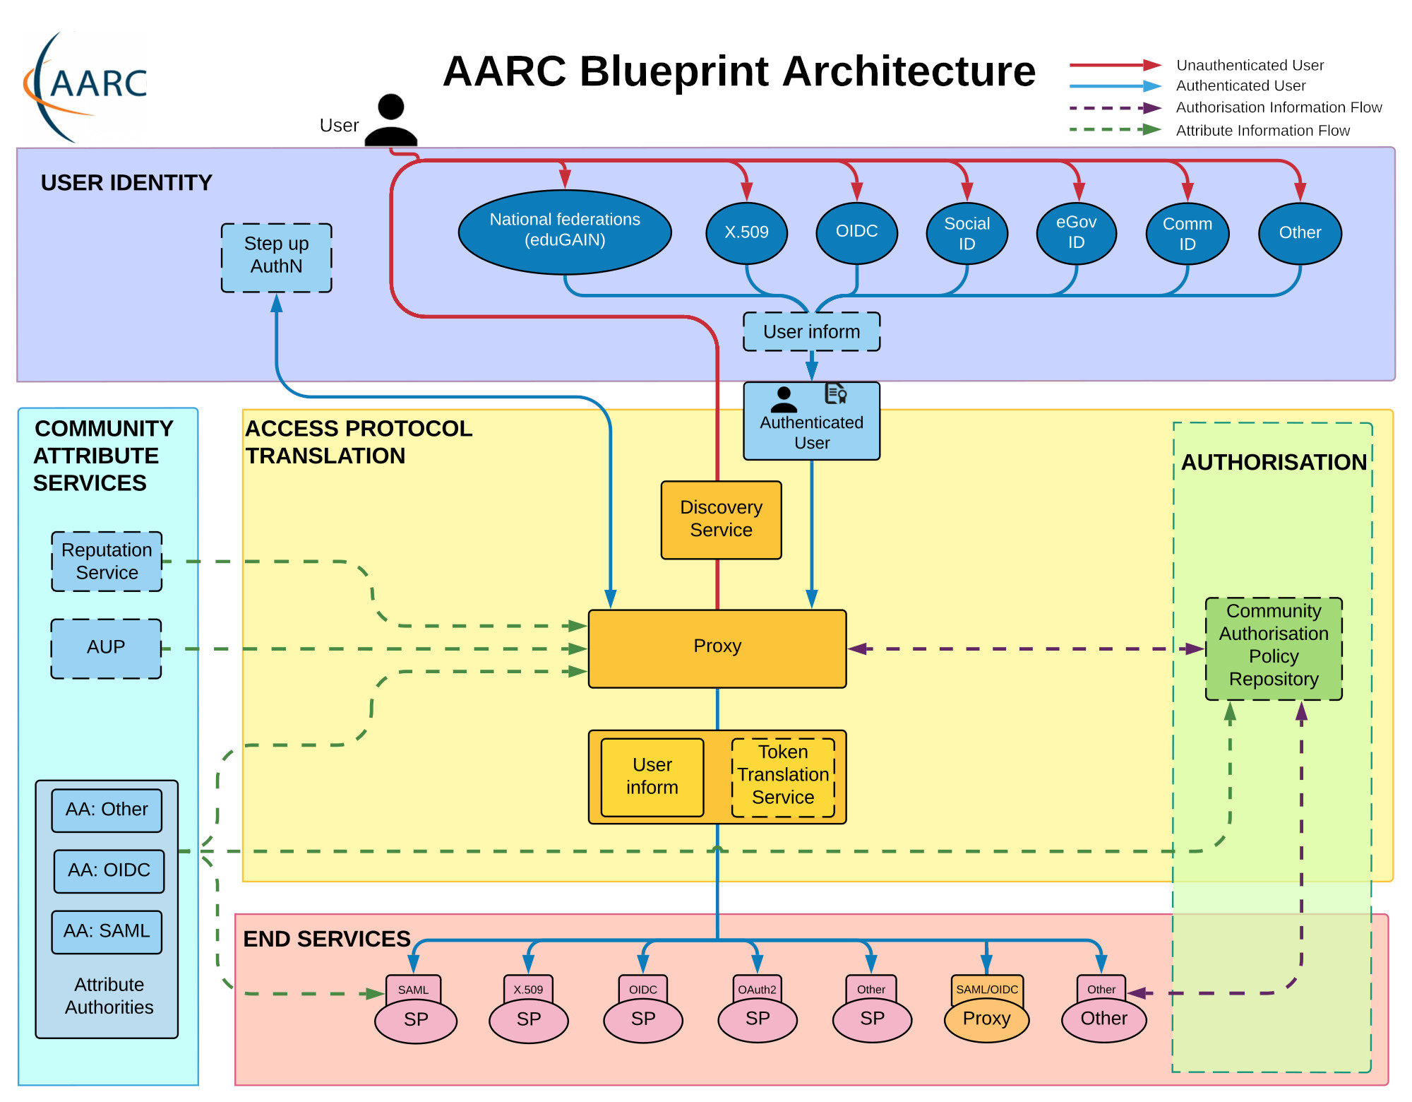
Notes:
Where this image comes from - there is a host of information available – https://aarc-project.eu/
There is guideline information
there are policy templates such as SIRTFI – (Sirtfi describes practices and attributes that identify an organisation as being capable of effectively participating in incident response)
SNCTFI “Scalable Negotiator for a Community Trust Framework in Federated Infrastructure” - Snctfi proposes a policy framework to assess the ‘quality’ of service provider and identity provider (SP-IdP) proxies – such as adherence to the Data Protection Code of Conduct (DPCoCo), REFEDS Research and Scholarship (R&S) entity category, Sirtfi .
These policies exist for the simple reason that Research in todays world is inherently distributed, and users would be accessing resources outside of their home institution, and in this world, the question of trust for users, service providers, and infrastructure is important. The policies I mentioned are there to facilitate and regulate trust between parties – the above policies are essentially measures undertaken by parties to principally cover security measures, user management and data protection.
there are technical integrations – aarc in action
there is training materials available….
Briefly explain each layer
User Identity layer - The User Identity Layer includes services which provide electronic identities that can be used by users participating in International Research Collaborations – so like your IdP of choice
The Access Protocol translation layer, defines an administrative, policy and technical boundary between the internal services and resources of the initiative and any other external services and resources.
Is also the layer where discovery service/consent, or rather “user inform” lives
Side tangent – there are different types of Discovery available, and there are 3 major types (https://testsp.safire.ac.za).
SeamlessAccess which follows recent guidelines resulting from the RA21 initiative. It is using the standard flavour of the Seamless Access discovery service, and is current best practice.
eduGAIN DSX embedded discovery service with the link placed top-right as recommended in the REFEDS discovery guide. DSX is however due to be decomissioned.
The "[Log In via SAFIRE]" button below demonstrates central discovery using the SAFIRE hub's discovery service. This mechanism limits logins to South African institutions utilising SAFIRE. Its use is deprecated as local discovery mechanisms (such as the two shown here) provide a much more consistent user experience.
there currently exists challenges where there are different ways to log into services out there, some good, some bad, some horrible and it is what the likes of the RA21 initiative are trying to resolve - Essentially, given 2 of the 3 I showed you are deprecated, and SeamlessAccess is the current best practice, You can see the aim is to standardize the user experience when making use of federated services.
Layer also provide guarantees that may not be met by the external IdPs alone, such as unique, persistent identifiers in the token translation service
Importantly, this layer is where the ‘Proxy’ lives
The Community Attribute Services Layer is related to managing and providing information (attributes) about users, such as community group memberships and roles, on top of the information that might be provided directly by the identity providers from the User Identity Layer.
The End Services Layer contains the services users want to use.
I purposefully left this layer for last, as there is a small side tangent to this, and is something important to keep in mind, being the difference between AuthN in the the user identity, and Access Protocol layer, and Authorisation or AuthZ in the Authorisation Layer – this Layer of course, is responsible for providing authorisation of access to services.

Slide 3
Access to Services
When you manage a shared application or service, you must guarantee it is accessed only by people that have the right to use it.
To achieve this goal, two distinct processes must exist:
AuthN or the Authentication of a user
AuthZ, which are there to enforce authorisation rules for that user
Notes:
This is going to just be a brief overview of AAI, in previous workshops, we usually make AAI a separate session, so I will run through the higher level detail quickly
Authentication of a user or AuthN
Authn primarily deals with user identity: who is this person?

Slide 4

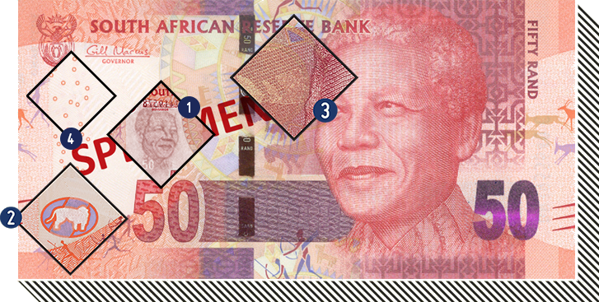
Authentication (AuthN)
Authentication is the act of confirming the veracity (truth) of an attribute of a single piece of data or entity
In the digital world, we tend to simplify this confirmation by using a username and password
South African Reserve Bank
Sunday Express
Notes:
The assumption is that a password is known only to the intended user, so by specifying the right password you demonstrate you are actually who you pretend to be.
Passwords are not the only way to do this. Authentication of people can generally be broken down into three groups:
Something you know (password)
Something you have (token)
Something about you (fingerprint)

Slide 5
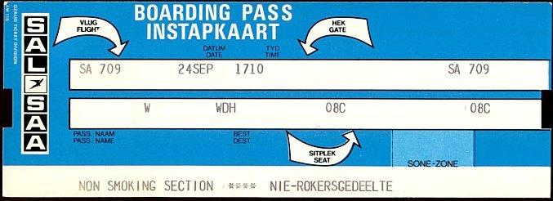
Authorisation (AuthZ)
Authorisation is the function of specifying access rights to resources in accordance with information security and access control criteria.
  More formally, to authorise is to define an access policy
http://www.airticketshistory.com/
Notes:
Authorisation is point-in-time, and can change
If you got an SAA boarding pass today, they might be out of business tomorrow
In the digital world, defining access rules per user is often impractical, Instead we define rules based on role:
Users are pooled into groups based on the way they fit into an organisation (e.g. payroll manager, principle investigator, …)
Access rights are then associated with those roles
To authorise is to define an access policy and can be based on User Attributes, such as
User Role, or RBAC for short - Role Based Access Control
GBAC (group)
PBAC (policy),
ABAC (attribute)
And more:
• on the entitlements users might have been granted,
• on the affiliations of the users,
• on the strength of the authentication method used or the quality of the user information or
• on combinations of these

Slide 6

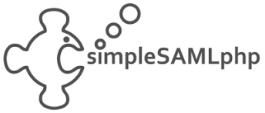
Tools to help with AuthN
SaToSa
Notes:
Shibboleth https://www.shibboleth.net/
SimpleSAMLphp - https://simplesamlphp.org/
SaToSa - https://github.com/IdentityPython/SATOSA

Slide 7

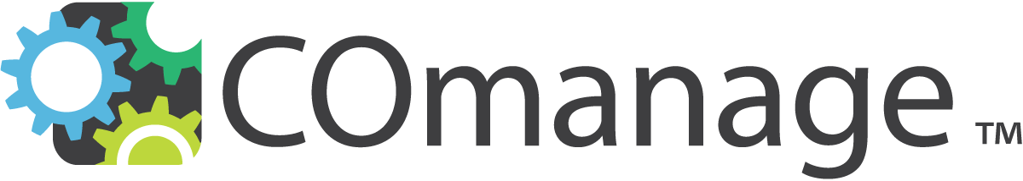

Tools to help with AuthZ
Notes:
Perun - https://perun-aai.org/
Comanage - https://www.incommon.org/software/comanage/
Grouper - https://www.incommon.org/software/grouper/
Perun is an Identity management systems – that can help you manage things like
Virtual organizations
User management
Group management
CoManage: also form of Identity Management system can be used to support research virtual organizations, as a guest user management system, or as a campus registry
Grouper is used to manage attribute/role-based authorization services and group memberships

Slide 8
Demo
Notes:
So I will show you an example of this that exists in South Africa - login.nren - This service provider proxy built by the South African NREN facilitates logins to many SA NREN services, and allows authentication via the South African Identity Federation (SAFIRE), eduGAIN as well as a number of social login providers – this Proxy is a lightweight embodyment of the framework outlined in the BPA from what we determined was needed by our community, and based on the framework building blocks…..
show each step, and how it relates to the diagram
- https://lists.tenet.ac.za – click login – note the proxy from the “Access Protocol translation layer” – I will touch on this again in a short bit, but Remember I mentioned earlier the proxy takes the responsibility for providing the connection to the identity federations, thus reducing the need for each service having to separately connect to a federation – you can see this with this lists service, in that it is not part of eduGAIN, but you can make use of entities from eduGAIN to login to this service.
But let me show you each layer of the architecture
access sanren filesender – this is an example of what I mentioned in the architecture – the End Services Layer.
- show login via institution – this is in Access Protocol translation layer– Note we have hit “the proxy”, and where you can see the discovery service I mentioned – select IdP – note this is per the User Identity layer of the BPA – note we are presented with “consent”, or rather user inform
- show login via social logins – do a login with MS account, and show that I am not ‘authorised’, as per the the Authorisation Layer – the ‘business’ rule built into this proxy is that it is enforcing affiliations –
- show linking of uni
The thing to know here is, that it is by no means a free for all, as I do not want to allow donald.trump17@gmail.com to be able to access my research collaboration do I ? - the problem with social accounts, is that they are
self asserted - so I need some way to be able to make sure that social accounts can be linked to someone from an institution - show authorisation block in architecturte diagram, and demo linking social account to Uni account

Slide 9

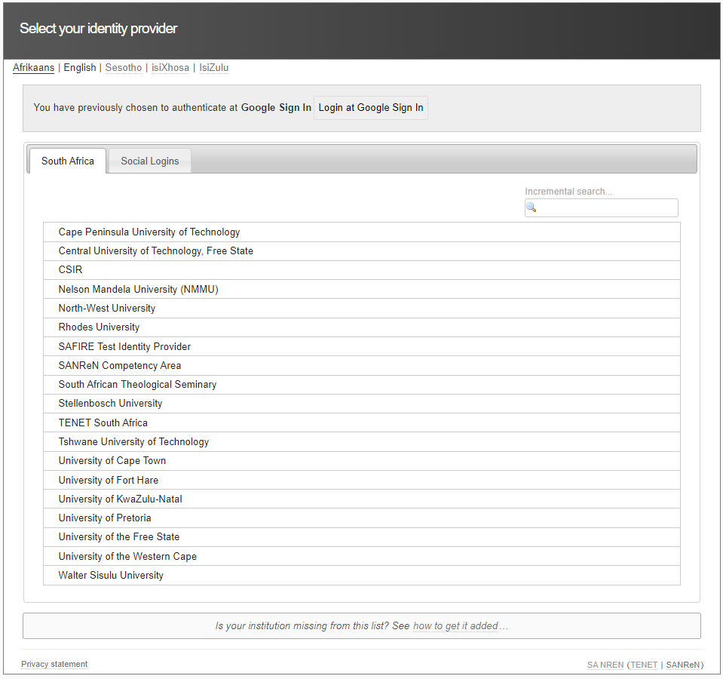



Affiliated
Discovery
User Inform
Notes:
User Identity layer - provide electronic identities – your Identity Provider, the user logs in and provides attributes from the IdP.
Access Protocol translation layer – The Proxy, Then the discovery Interface
The user proves affiliation with an institution in the authorisation layer, by logging into one of ‘allowed’ institutions, and is informed of attribute transfer
or, if log in occurs via a social login, a link to a Bonafede institution must first be established, and The Community authorisation policy populates a local attribute authority, and keeps track, and subsequently asserts the “additional” attribute of ‘mail’ for the linked account.
the user is granted access to the service. In the end services layer.

Slide 10


BPA-as-a-Service
Notes:
eduTEAMS - eduTEAMS enables members of the research and education community to create and manage virtual teams and securely access and share common resources and services using federated identities from eduGAIN and trusted Identity Providers - https://eduteams.org/
CILogon - The "CILogon 2.0" project provides an IdAM platform that enables scientists to work together to meet their IdAM needs more effectively so they can allocate more time and effort to their core mission of scientific research. - https://www.cilogon.org/2

